Slide 1
A Machine Learning based Image Forgery Detection
Alif Al Hasan
Exam Roll: 180671
Session: 2017-2018
Mohammad Ashraful Islam
Assistant Professor
Department of CSE
Mehedi Hasan
Exam Roll: 180673
Session: 2017-2018
Sunday, 28 May, 2023

Slide 2
Slide Outline
Overview
Motivation
Problem Definition
Literature Review
Background Technologies
System Model
Dataset
Evaluation Policy
Result & Discussion
Limitation
Future Scopes
Conclusion
References

Slide 3
Overview
Images are visual representations of objects, scenes, or concepts captured or created through various means.
Digital photographs can effectively convey a variety of sorts of information.
Quick development of cameras and other image acquisition technologies have made it possible to capture large amounts of images.
Quick development of memory devices have made it possible to collect and store large amounts of images.

Slide 4
Overview(cont..)
Every day, new images are added to the digital platforms, which are used by millions of people all over the world.
Images are now being forged and used to conceal sensitive information and to spread false information.
As a result, we need image forgery detection systems to proof the legitimacy of digital images.

Slide 5
Motivation
Billions of images stored and shared all over the internet and the amount is increasing daily.
Several image editing tools exist like GIMP, Adobe Photoshop, Pixlr, Canva, Inkscape, Fotor, Snapseed, and more.
Their ease of use and availability across all platforms have made altering digital images very easy.
Digital photos may now be used to conceal sensitive information, create obscene graphics, and spread false information.

Slide 6
Motivation(cont..)
We have implemented the system to identify forgeries like copy-move and splicing.
Forgery detection systems can proof the authenticity and legitimacy of digital images.

Slide 7
Problem Definition
Determine image authenticity: The main objective is to identify whether a digital image has been altered or manipulated without leaving obvious signs of tampering.
Detection of forgeries: Specifically identify copy-move or splicing forgeries.

Slide 8
Literature Review
Authors | Project Name | Used Technique | Accuracy
Alahmadi et al. [1] | Passive detection of image forgery using DCT and Local Binary Pattern | Extracts frequency components and texture features, using the information to train a support vector machine (SVM) classifier to determine image authenticity | 98.5%
Parnak et al. [2] | A novel image splicing detection algorithm based on generalized and traditional Benford’s law | Generalized and conventional Benford’s Law | 91.6%
Manzarul et al. [3] | A robust forgery detection method for copy–move and splicing attacks in images | Scale-invariant feature transform (SIFT) and discrete cosine transform (DCT) approaches are the foundation of their algorithm | 96.8%

Slide 9
Literature Review(cont..)
Authors | Project Name | Used Technique | Accuracy
Shilpa et al. [4] | Image forgery detection based on statistical features of block DCT coefficients | Block discrete cosine transform (DCT) coefficients’ statistical properties | 98.2%
Mahmood et al. [5] | A survey on block based copy move image forgery detection techniques
Soumen et al. [6] | Copy-move image forgery detection using SVD | An image is first broken down into its component parts using SVD, and then comparable image patches are grouped together using a clustering algorithm | 95.3%
Mohammed et al. [7] | Detection of copy-move image forgery based on discrete cosine transform | A clustering algorithm groups comparable characteristics after using DCT to extract features | 89.1%

Slide 10
Background Technologies
Discrete Cosine Transform (DCT):
Discrete Cosine Transform is a well-liked method for compressing and analyzing images.
A set of frequency coefficients are created from an image using DCT.
The energy content of the image can be represented in various frequency bands using these frequency coefficients.
DCT is frequently used in image forgery detection to spot areas that have been altered by copy-move or splicing operations.
DCT is utilized for lossy image compression due to its extremely powerful energy compaction.
A block of an 8 × 8 matrix must be created from the input image to execute DCT on it.

Slide 11
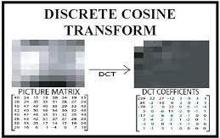
Background Technologies(cont..)
The discrete cosine transform (DCT) aids in delineating the various spectral bands within the image.
Fig - 1: Discrete Cosine Transform

Slide 12
Background Technologies(cont..)
Local Binary Pattern (LBP):
Local binary pattern is a technique for examining texture in photographs that generates a binary code for each pixel based on comparisons between its intensity and that of the pixels around it.
By spotting changes or inconsistencies in an image’s texture, LBP is widely used to spot image fraud.
This method gained widespread recognition following the release of an article by Ojala et al [9].
Using each pixel and its surrounding pixels as a starting point, local binary patterns produce a local interpretation of texture.
It is necessary to transform the image to grayscale to construct an LBP texture description.

Slide 13
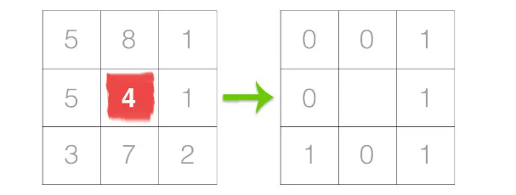
Background Technologies(cont..)
Choose a neighborhood of a given radius (designated as ”r”) around each pixel in the grayscale image.
A value for the center pixel is determined using LBP and recorded in a 2D array with the same dimensions as the original image.
Fig - 2: First step of LBP

Slide 14
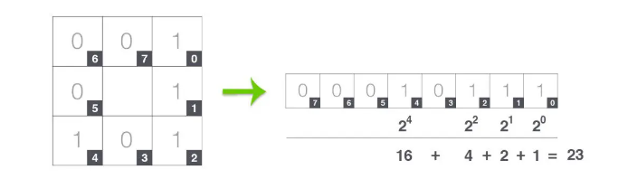
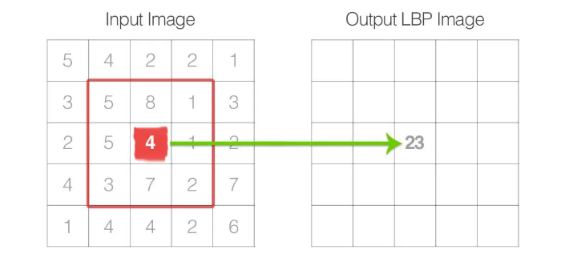
Background Technologies(cont..)
Fig - 3: Second step of LBP Fig - 4: Final step of LBP

Slide 15
Background Technologies(cont..)
Support Vector Machine (SVM):
Support Vector Machine, or SVM, is utilized for classification.
Main objective is to identify the best decision boundary for separating the many categories that are available in a dataset.
Each data point is represented as a point in n-dimensional space (where ’n’ denotes the number of attributes).
Value of each feature is associated with a particular position.
Classification is carried out by locating the hyperplane dividing the two categories.
When the data can be divided into equal halves along a single line, it is said that the linear kernel is being used.

Slide 16

Background Technologies(cont..)
Fig - 5: Working principle of SVM

Slide 17
System Model
Preprocessing:
Chroma channels are superior to the other channels at encoding tampering traces.
First the RGB image is converted into a YCbCr image, where Y stands for the luminance component and Cb and Cr are the chroma channels.
Majority of the image data is kept in the Y channel and so the luminance component is easier for the human eye to distinguish.
Majority of tampering traces that cannot be detected with the naked eye are buried in the chroma channels.
Consequently, the chroma channels are essential for spotting tampering.
To get around this problem, our system employs all three channels—Y, Cb, and Cr—and combines the derived features from each of the three components to produce a final feature.

Slide 18
System Model(cont..)
Feature Extraction(Modeling the DCT domain tampering traces):
Tampering traces are modeled by LBP and 2D DCT.
An initial 50% overlap block division of a chroma component is performed to aid with localization.
After that, each block is put through the LBP operator to highlight and bring to light any tampering artifacts present in the host image.
LBP operator is then used to each block to discover instances of micro-patterns and highlight any tampering artifacts.
Then 2D DCT is employed to translate each block of LBP codes into the frequency domain to detect changes in the local frequency distribution.
Standard deviations of the corresponding DCT coefficients are used to construct a feature vector.

Slide 19
System Model(cont..)
Classification:
The main challenge is determining if an image is authentic or has been manipulated.
Support Vector Machine (SVM) has proven to perform exceptionally well in a variety of two-class tasks.
Classification is performed using SVM and Radial Basis Function (RBF).
The SVM classifier defines a perfect hyperplane that separates the data into two categories.
The best hyperplane to use to increase the generalization of the classifier is the greatest margin hyperplane.

Slide 20
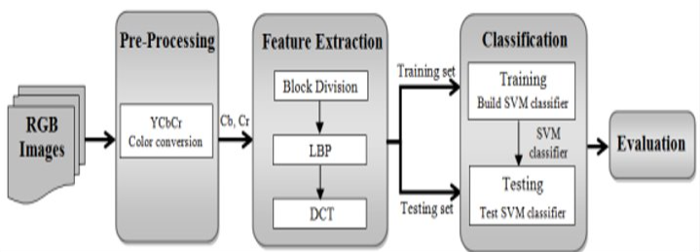
System Model(cont..)
Fig - 6: System Design of our model

Slide 21
Dataset
Table - 1: Description of the three datasets used in the project
Dataset | Authentic Images | Tampered Images | Total | Image Type | Image Size
CASIA - 1 | 800 | 921 | 1721 | JPG | 384x256, 256x384
CASIA - 2 | 7491 | 5123 | 12614 | JPG, TIFF, BMP | 240x160 to 900x600
Columbia | 183 | 180 | 363 | TIFF, BMP | 757x568 to 1152x768

Slide 22
Evaluation Policy
Model has been evaluated using 5 different evaluation policies:
Accuracy scores
Cross-validation
F1-score
Precision
Recall

Slide 23
Result & Discussion
On CASIA1 dataset our model shows 97.11% accuracy score and the cross-validation score of 97.09% using 10-fold. It gains a precision value of 0.97, an f-score of 0.97, and a recall value of 0.97.

Slide 24
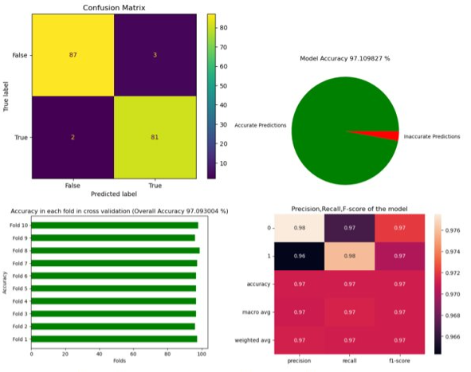
Result & Discussion(cont..)
Fig - 7: Different performance measures on CASIA1 dataset

Slide 25
Result & Discussion(cont..)
On CASIA2 dataset, proposed model shows 96.59% accuracy score and the cross-validation score of 97.14% using 10-fold . It gains precision, f-score, and recall value each of 0.97.

Slide 26
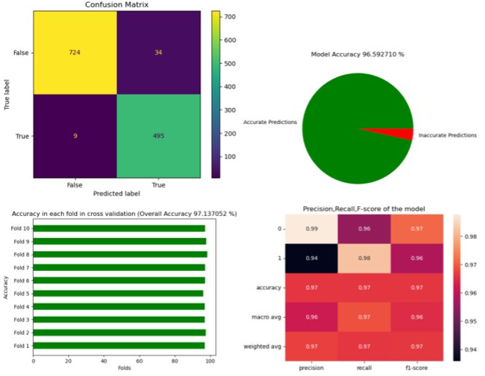
Result & Discussion(cont..)
Fig - 8: Different performance measures on CASIA2 dataset

Slide 27
Result & Discussion(cont..)
On the COLUMBIA dataset, proposed model shows 89.19% accuracy score and the cross-validation score of 77.91% using 10-fold. It gains precision, f-score, and recall value each of 0.89.

Slide 28
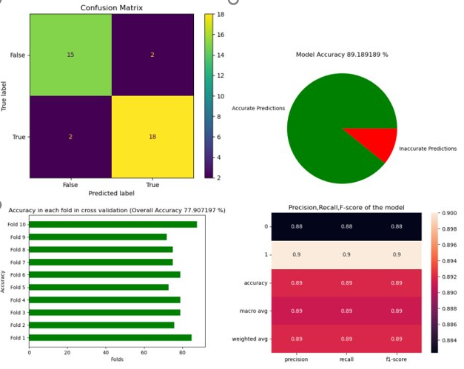
Result & Discussion(cont..)
Fig - 9: Different performance measures on COLUMBIA dataset

Slide 29
Result & Discussion(cont..)
System performance varies depending on different factors:
Block size
RBF kernel parameters (gamma, C).
System design
Specific dataset

Slide 30
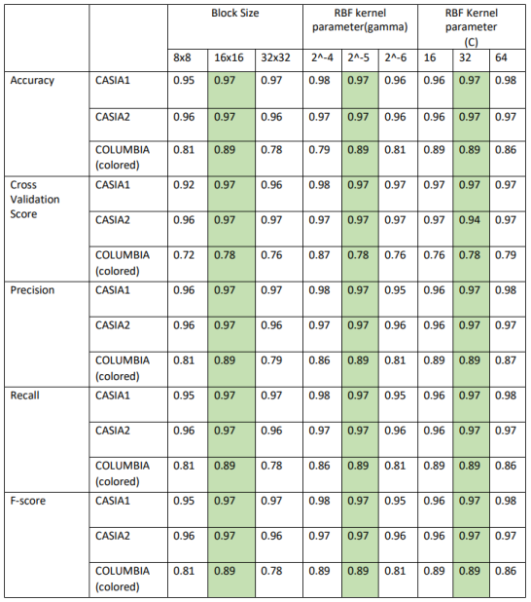
Result & Discussion(cont..)
Table - 2: Performance scores on different RBF parameters

Slide 31
Limitations & Challenges
Limitations:
Image quality matters.
Forger can work smarter to trick the system.
Fails to perform well if dataset is diverse.
Challenges:
Examination of image properties
Preservation of original image integrity
Efficiency and scalability
Utilization of appropriate techniques
High accuracy

Slide 32
Future Scopes
Increasing accuracy
Detecting other types of image forgeries other than copy move and splicing such as counterfeiting, including filter-based forgery, retouching forgery, object removal forgery, and geometric forgery.
Training the system with more intricate and vast dataset.

Slide 33
Conclusion
In this project SVM along with DCT have been used to classify authentic and tampered images. Currently, people are taking billions of pictures every day which are being used in many situations. But in some situations, the authenticity of these images become a matter of concern due to many reasons. The availability of many image editing tools make these situations harder as nowadays anyone can tamper an image not needing any serious level of skills. In our project, we have built a system that can recognize tampered images using Copy move and Splicing techniques. Our system can recognize these types of image tampering with reliable accuracy and a reasonable amount of time.

Slide 34
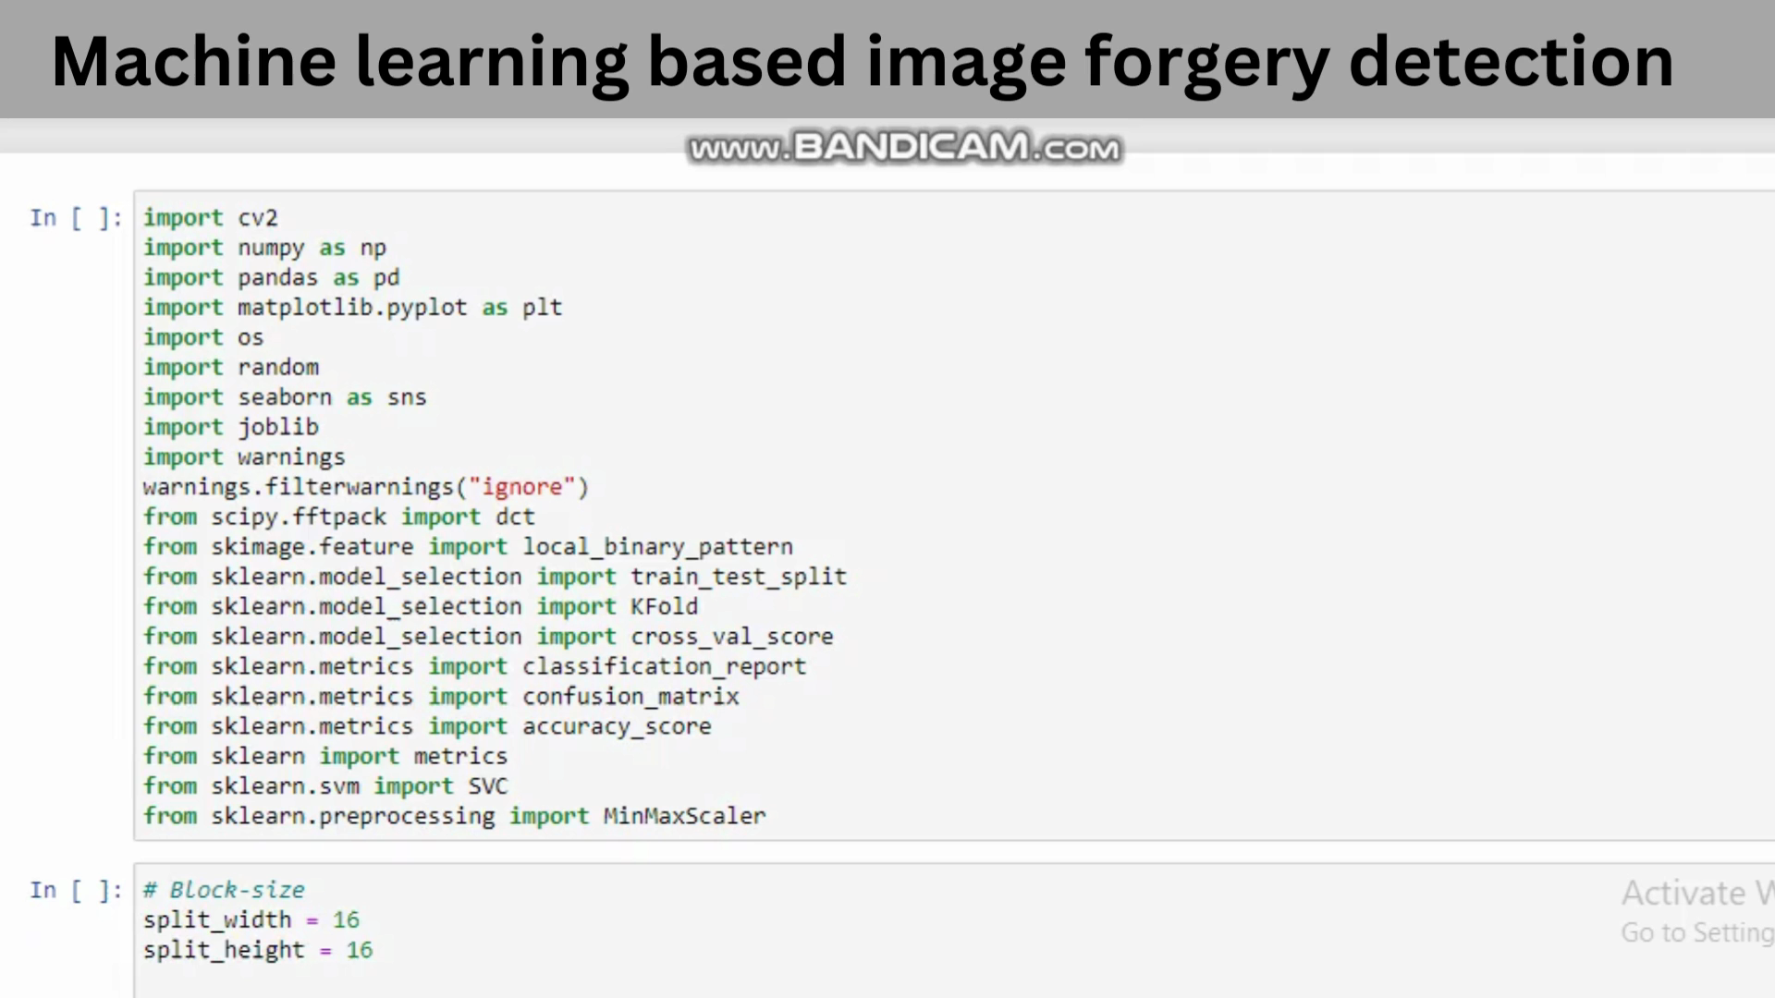
VIDEO DEMONSTRATION FOR THE PROJECT WORK

Slide 35
References
[1] Amani Alahmadi, Muhammad Hussain, Hatim Aboalsamh, Ghulam Muhammad, George Bebis, and Hassan Mathkour. Passive detection of image forgery using dct and local binary pattern. International Journal of Advanced Computer Science and Applications, 9(2):37–43, 2018.
[2] A. Parnak, Y. Baleghi Damavandi, and S. J. Kazemitabar. A novel image splicing detection algorithm based on generalized and traditional benford’s law. International Journal of Computer Science and Network Security, 20(5):154–160, 2020.
[3] Mohammad Manzurul Islam, Gour Karmakar, Joarder Kamruzzaman, and Manzur Murshed. A robust forgery detection method for copy–move and splicing attacks in images. Journal of Forensic Sciences, 62(4):1036–1044, 2017.

Slide 36
References(cont..)
[4] Shilpa Duaa, Jyotsna Singha, and Harish Parthasarathya. Image forgery detection based on statistical features of block DCT coefficients. Multimedia Tools and Applications, 75(8):4495– 4515, 2016.
[5] Toqeer Mahmood, Tabassam Nawaz, Rehan Ashraf, Mohsin Shah, Zakir Khan, Aun Irtaza, and Zahid Mehmood. A survey on block based copy move image forgery detection techniques. Journal of King Saud University-Computer and Information Sciences, 32(3):324–335, 2020.
[6] Soumen K. Patra and Abhijit D. Bijwe. Copy-move image forgery detection using SVD. International Journal of Computer Applications, 117(20):33–38, 2015.

Slide 37
References(cont..)
[7] Mohammed Hazim Alkawaz, Ghazali Sulong, Tanzila Saba, and Amjad Rehman. Detection of copy-move image forgery based on discrete cosine transform. Journal of Visual Communication and Image Representation, 52:118–128, 2018.
[8] Youtube. https://www.youtube.com/watch?v=F5pMHaofd7c.
[9] Timo Ojala, Matti Pietik¨ainen, and Topi M¨aenp¨a¨a. Multiresolution grayscale and rotation invariant texture classification with local binary patterns. Proceedings of the IEEE International Conference on Pattern Recognition, 1:II–210–II–213, 2002.
[10] pyimagesearch. https://pyimagesearch.com/2015/12/07/ local-binary-patterns-with-python-opencv/.
[11] Javatpoint. https://www.javatpoint.com/machine-learning-support-vector-machine-algorithm.

Slide 38
Thank You

